Slide 1


Front end
(Introduction to css)
Lecture-16

Slide 2

Today’s Agenda
Styling Lists In CSS
CSS List Properties
Making Nav Bar Using List

Slide 3
Styling Lists In CSS
CSS provides several properties for styling and formatting the most commonly used unordered and ordered lists.
These CSS list properties typically allow you to:
Control the shape or appearance of the marker.
Set the distance between the marker and the text in the list.
Specify an image for the marker rather than a bullet point or number.

Slide 4
Styling Lists In CSS
Following are the properties provided by CSS for styling any list:
list-style-type
list-style-position
list-style-image
list-style

Slide 5
The list-style-type Property
The list-style-type property allows us to control the shape or style of marker in the list.
For unordered lists possible values are:
none
disc
circle
square

Slide 6
Example
ul
{
list-style-type: none;
}
This will style all unordered list to be displayed without any marker , instead of bullets.

Slide 7
The list-style-type Property
For ordered lists possible values are:
Value | Description | Example
decimal | Number | 1,2,3,4,5
decimal-leading-zero | 0 before the number | 01, 02, 03, 04, 05
lower-alpha | Lowercase alphanumeric characters | a, b, c, d, e
upper-alpha | Uppercase alphanumeric characters | A, B, C, D, E
lower-roman | Lowercase Roman numerals | i, ii, iii, iv, v
upper-roman | Uppercase Roman numerals | I, II, III, IV, V

Slide 8
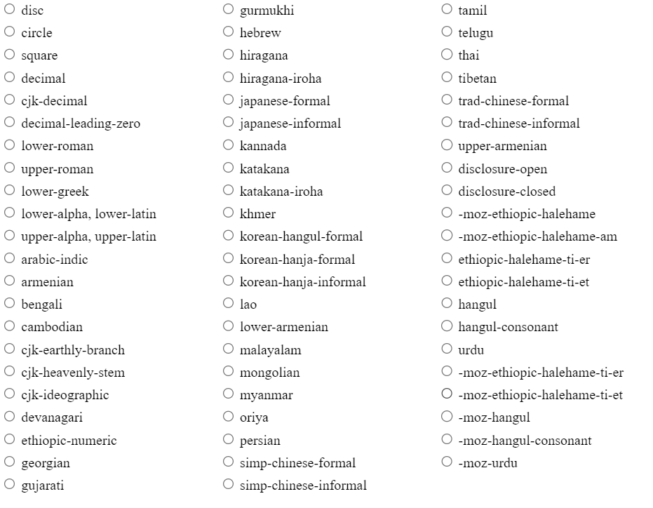
All Possible Values

Slide 9
Example
ol
{
list-style-type: decimal-leading-zero;
}
This will style all ordered list to be displayed 0 prefixed numbers as marker , for single digit numbers

Slide 10
The list-style-position Property
By default, the marker of each list item is positioned outside of their display boxes.
However, we can also position these markers or bullet points inside of the list item's display boxes using the list-style-position property along with the value inside.
In this case the lines will wrap under the marker instead of being indented

Slide 11
Example
ol.in li
{
list-style-position: inside;
}
ol.out li
{
list-style-position: outside;
}

Slide 12
The list-style-image Property
We can also set an image as a list marker using the property list-style-image .
Example:
ul li {
list-style-image: url("images/bullet.png");
}
The style rule in the above code assigns a PNG image “bullet.png" as the list marker

Slide 13
Setting All List Properties At Once
The list-style property is a shorthand property for defining all the three properties : list-style-type, list-style-image, and list-style-position of a list in one place.
Example:
ul
{
list-style: square inside url("images/bullet.png");
}

Slide 14
Creating Nav Bar Using Lists
HTML lists are frequently used to create horizontal navigation bar or menu that typically appears at the top of a website.
But since the list items are block elements, so to display them inline we need to use the CSS display property.

Slide 15
Example
ul
{
padding: 0;
list-style: none;
background: #f2f2f2;
}
ul li
{
display: inline-block;
}
ul li a
{
display: block;
padding: 10px 25px;
color: #333;
text-decoration: none;
}
ul li a:hover
{
color: #fff;
background: #939393;
}

Slide 16

End Of Lecture
For any queries mail us @: scalive4u@gmail.com
Call us @ : 0755-4271659, 9826686245
Agenda for Next Lecture:
Styling Tables In CSS

